Slide 1
COMPANY PROFILE
ISO CERTIFIED COMAPANY ISO 9001:2015 & ISO 45001:2018

Slide 2
WHO WE ARE
Alies Automation Company W.L.L is a unique system integrator and turnkey contractor offering out-of-the-box solutions in the building automation industry.
We are established to provide quality service to the customers who are looking for un-interrupted supply. We has vast expertise and in-depth knowledge of the market in this region and can cater to any potential customers according to their requirements.
We wish to take this opportunity to inform you that with our continued process improvement, and offer our all clients unmatched quality service and maintain our market superiority.
We Alies Automation Company W.L.L are a step ahead to focus and provide truly world class services related to HVAC automatic controls and control panels for the construction works in association with electromechanical building service companies.
OUR VISION
To be recognized as a trusted technology service partner by our clients and technology partners that provides world class technology solutions that meets or exceeds our client’s needs and expectations served by our intellectual network - our people.
OUR MISSION
To achieve highest levels of success by conducting ourselves as an organization with Clarity of Thought (in every action we take), Objectivity to Facts and Values (results perceived by our customers), and Integrity in our Approach and Deeds.
OUR VALUES
Quality, Innovation, Excellence and Customer Satisfaction are the four pillars on which the organization rests.
ISO CERTIFIED COMAPANY ISO 9001:2015 & ISO 45001:2018

Slide 3
WHY US?
Honest efforts
Professional approach
Consistent Delivery
High Quality Service
Competitive Price
Minimum Turn - Around Time
SERVICES OFFERED
Energy Efficient Enviroment Control
Building Automation Solution
HVAC Products
Panel Division
Maintenance and Contracting
ISO CERTIFIED COMAPANY ISO 9001:2015 & ISO 45001:2018

Slide 4
OUR PRODUCTS
POWER SOLUTIONS
Energy Efficient Environmental Control
Room Pressure Monitor / Controller
Fume Hood Monitor /Controller
Multiview Monitor for Multi Room/ Point
Room Monitor
Conditional Display
Building Automation Solutions.
Intelligent Building Management Systems(IBMS)
Lighting Contrtol System (LCS)
Industrial Automation System (PLCs,SCADA)
Standalone Control System.
HVAC Control System.
Leak Detection System.
HVAC Products
Variable/Constant Air Volume.
Meters (Flow/BTU/Water/KWH)
Thermostat (room/Duct)
Air Control Products
Control Sensor (Building and Industrial).
Current Sensor and Transducers.
Valves and actuator.
Panel Division
Motor Control Center (MCC).
Variable Speed Drives (VSD/VFD)
DDC / PLC Automation Panel,
Switchgears
Maintenance & Contracting Division
Annual Maintenance
Contracting – Cable Pulling and Termination – Electrical, Communication and OFC Cables.
ISO CERTIFIED COMAPANY ISO 9001:2015 & ISO 45001:2018

Slide 5
Make : CRC (USA)
Energy Efficient Environmental Control
Room Pressure Monitor / Controller (RPM) are specifically designed to give personnel a clear, accurate, and unambiguous indication of its pressure environment and alarm status. Unlike other monitors that include LEDs or LCDs with cluttered graphics and confusing / hard to use interfaces, RPM uses clear to understand graphics with a bright vibrant colour touch-screen that can be easily configured to meet and individual facilities needs
Fume Hood Monitor (CRC-FHM) is designed to monitor a single fume hood. The Fume Hood Controller (CRC-FHC) is designed to monitor and control a single fume hood where proper flow is vital.
Multiple Room Monitor is an advance compact display module that continuously monitors the occupancy and alarm status of up to four (4) Rooms.
MultiVIEW © Monitor is an advanced 7" LCD touchscreen display that was designed to be configured for any monitoring or sequencing application. It's core function is to give local access to critical information in an easy to read display.
ISO CERTIFIED COMAPANY ISO 9001:2015 & ISO 45001:2018

Slide 6
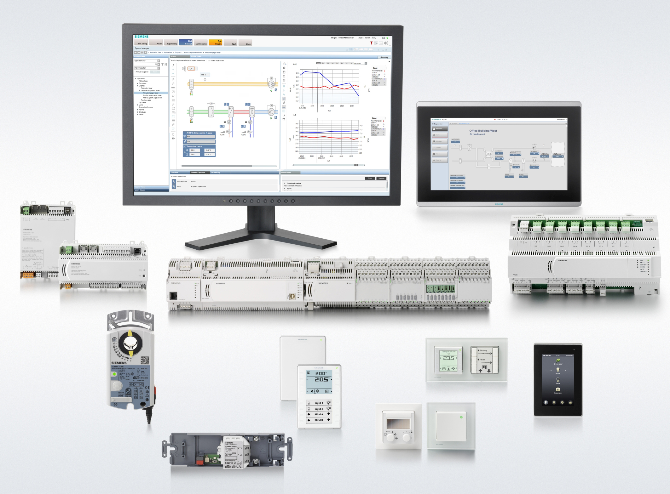
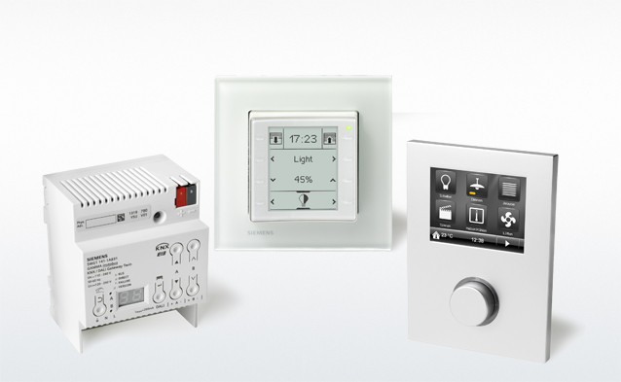
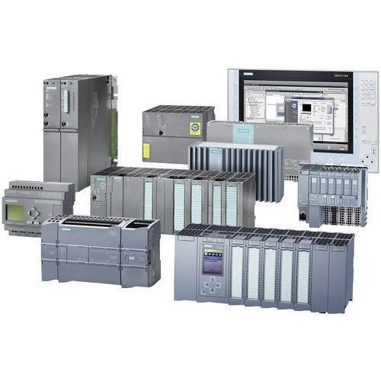
Building Automation Solutions
POWER SOLUTIONS
Intelligent Building Management Systems(IBMS) is mainly used for Monitoring and Controlling of HVAC Equipment, Electrical Equipment & Plumbing Equipment and Integrating of Fire Alarm System, CCTV, Access Controls, Elevators, and other ELV systems.
Building Automation Systems (BMS) are centralized, interlinked, networks of hardware and software, which monitor and control the environment in commercial, industrial, and institutional facilities. While managing various building systems, the automation system ensures the operational performance of the facility as well as the comfort and safety of building occupants. Typically, such control systems are installed in new buildings or as part of a renovation where they replace an out-dated control system
lighting control system is an intelligent network based lighting control solution that incorporates communication between various system inputs and outputs related to lighting control with the use of one or more central computing devices. Lighting control systems are widely used on both indoor and outdoor lighting of commercial, industrial, and residential spaces. Lighting control systems serve to provide the right amount of light where and when it is needed
Industrial Automation System needs for Industrial / PLC Automation & Control System; MIMIC Panel, ANNUNCIATOR SYSTEM, INSTRUMENTS and SCADA A PROGRAMMABLE LOGIC CONTROLLER (PLC) is an industrial computer control system that continuously monitors the state of input devices and makes decisions based upon a custom program to control the state of output devices
ISO CERTIFIED COMAPANY ISO 9001:2015 & ISO 45001:2018

Slide 7
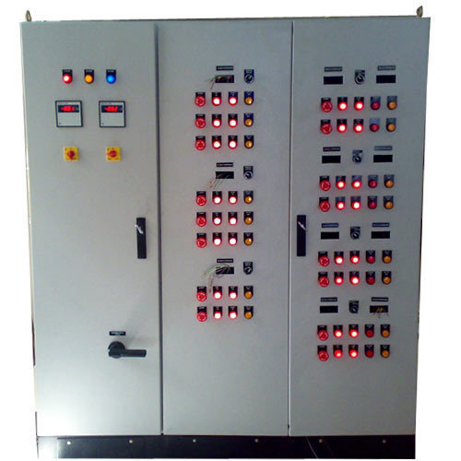
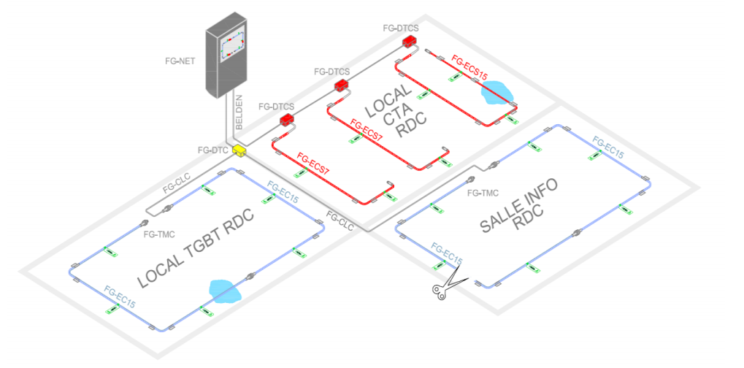
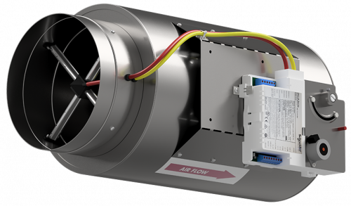
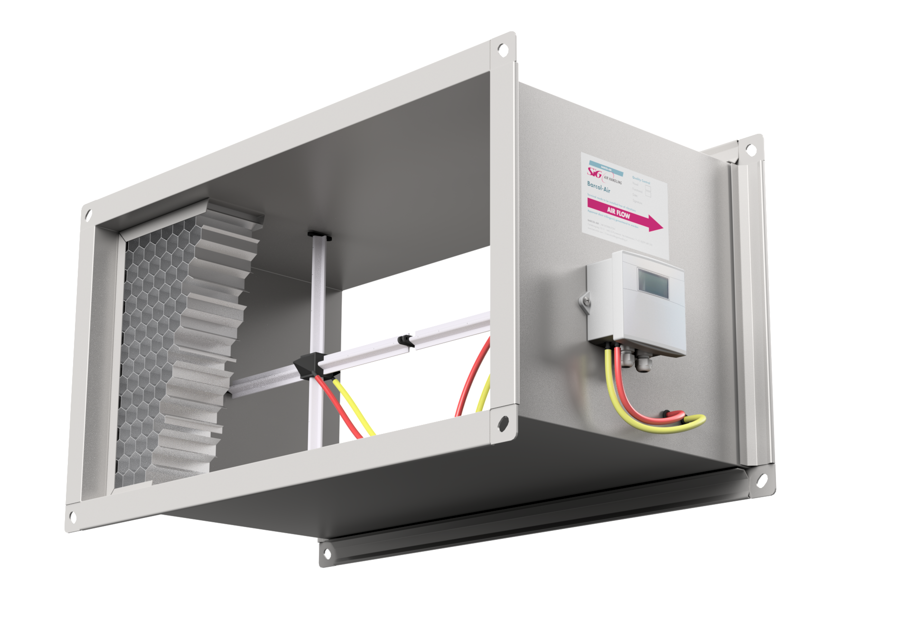
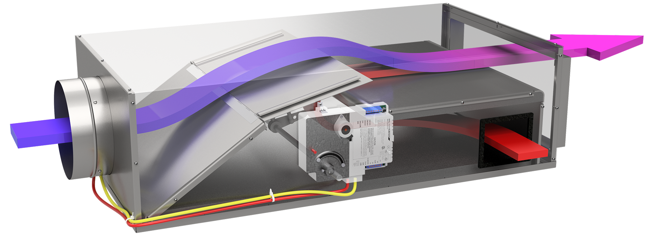
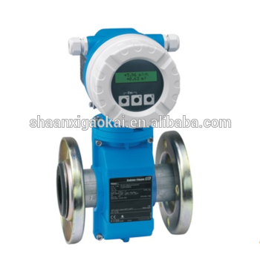
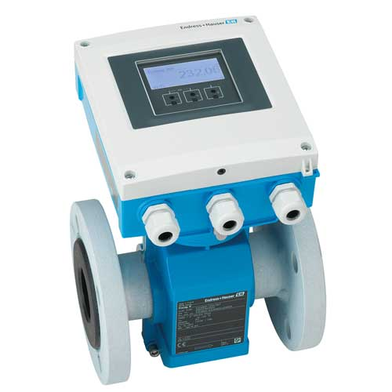
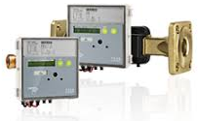
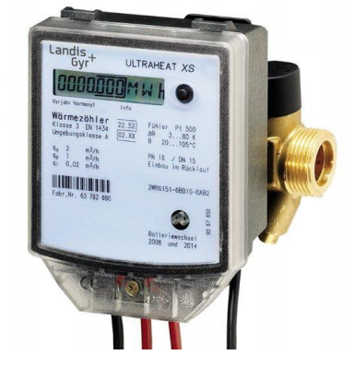
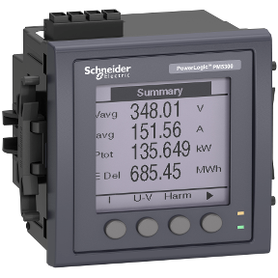
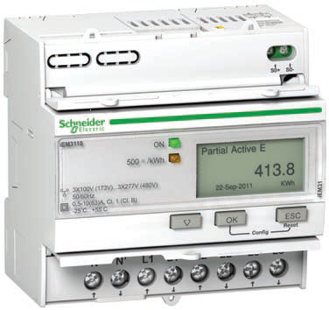
Building Automation Solutions
Standalone control System are a cost effective, direct form of controller. Purpose built and stand-alone in operation, they provide an economical and fully featured option for a HVAC controls system.
HVAC Control Panels feature agency-compliant standard and custom turnkey solutions designed to provide a solid protection package for the intelligent devices within your system
Leak Detection System use of protection continuously in areas of buildings that have a risk of water leakage. Lengths of water cable sense cables, which are pre-finished, are connected to each other, depending on the area to be protected. The water sense can be placed on false floors, air containers and drains and can be fixed on ground using fixing clips.
HVAC Products
Variable air volume (VAV) is a type of heating, ventilating, and/or air-conditioning system and vary the airflow at a constant temperature.
Constant air volume (CAV) supply a constant airflow at a variable temperature.
Meters (Flow/BTU/Water/KWH)
Flow meter is a device used to measure the flow rate or quantity of a gas or liquid moving through a pipe
BTU meters measure the energy content of liquid flow in British thermal units(BTU), a basic measure of thermal energy
KWH meter is a device that measures the most common unit of measurement on the electricity meter is the kilowatt hour [kWh], which is equal to the amount of energy used by a load
ISO CERTIFIED COMAPANY ISO 9001:2015 & ISO 45001:2018

Slide 8
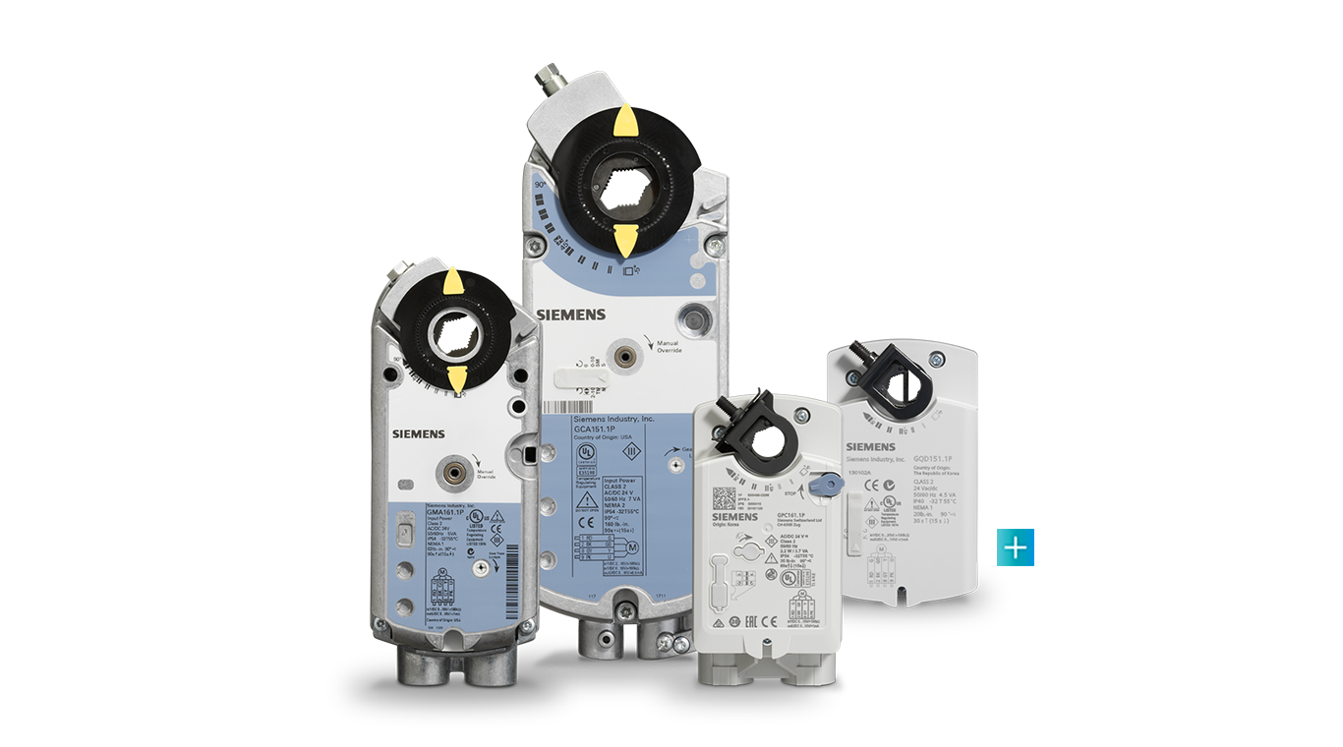
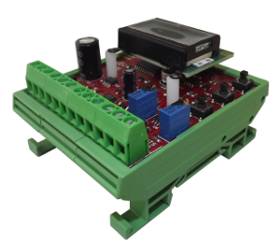
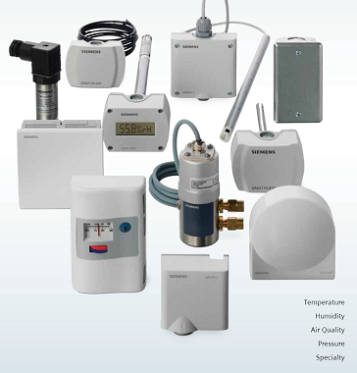
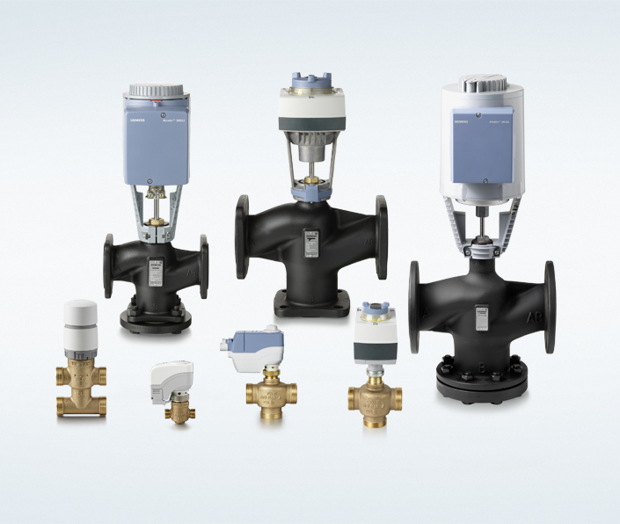
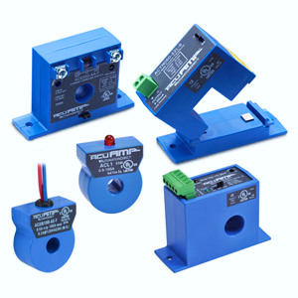
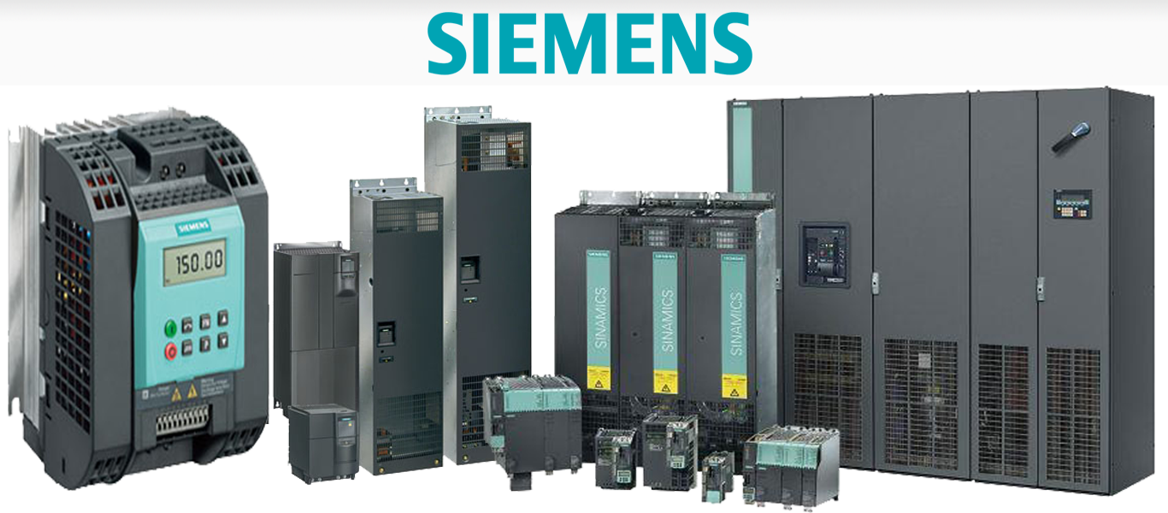
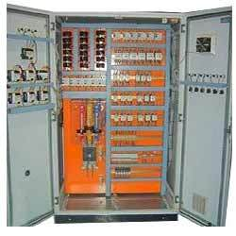
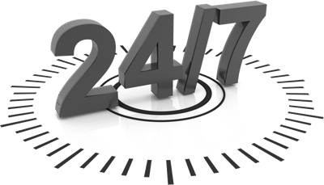
HVAC Products
Thermostat (room/Duct)
Air Control Products
Control Sensor (Building and Industrial).
Current Sensor and Transducers.
Valves and actuator.
POWER SOLUTIONS
PANEL DIVISION
In our Work Shop, we assemble all types of Motor Control Center (MCC), ACCP, Variable Frequency Drives, DDC Automation Panel, PLC Automation and Switchgears. We mainly deal with the best of Products from Siemens, ABB and Schneider but can offer you any other brand based on your technical and budgetary requirements. We cater to all your need of panels whether they be in Quantity, Size, Standard or Non-Standard or a special requirements to suit your needs.
MAINTENANCE AND CONTRACTING
Annual Maintenance and Technical Support.
Facility Management for Hotels, Hospital, Multistory Building, Shopping Mall and House Keeping Energy Auditing for Building Management system
Contracting.
We do undertake case to case for Cable Pulling and Termination – Electrical, Communication and OFC Cables.
ISO CERTIFIED COMAPANY ISO 9001:2015 & ISO 45001:2018

Slide 9
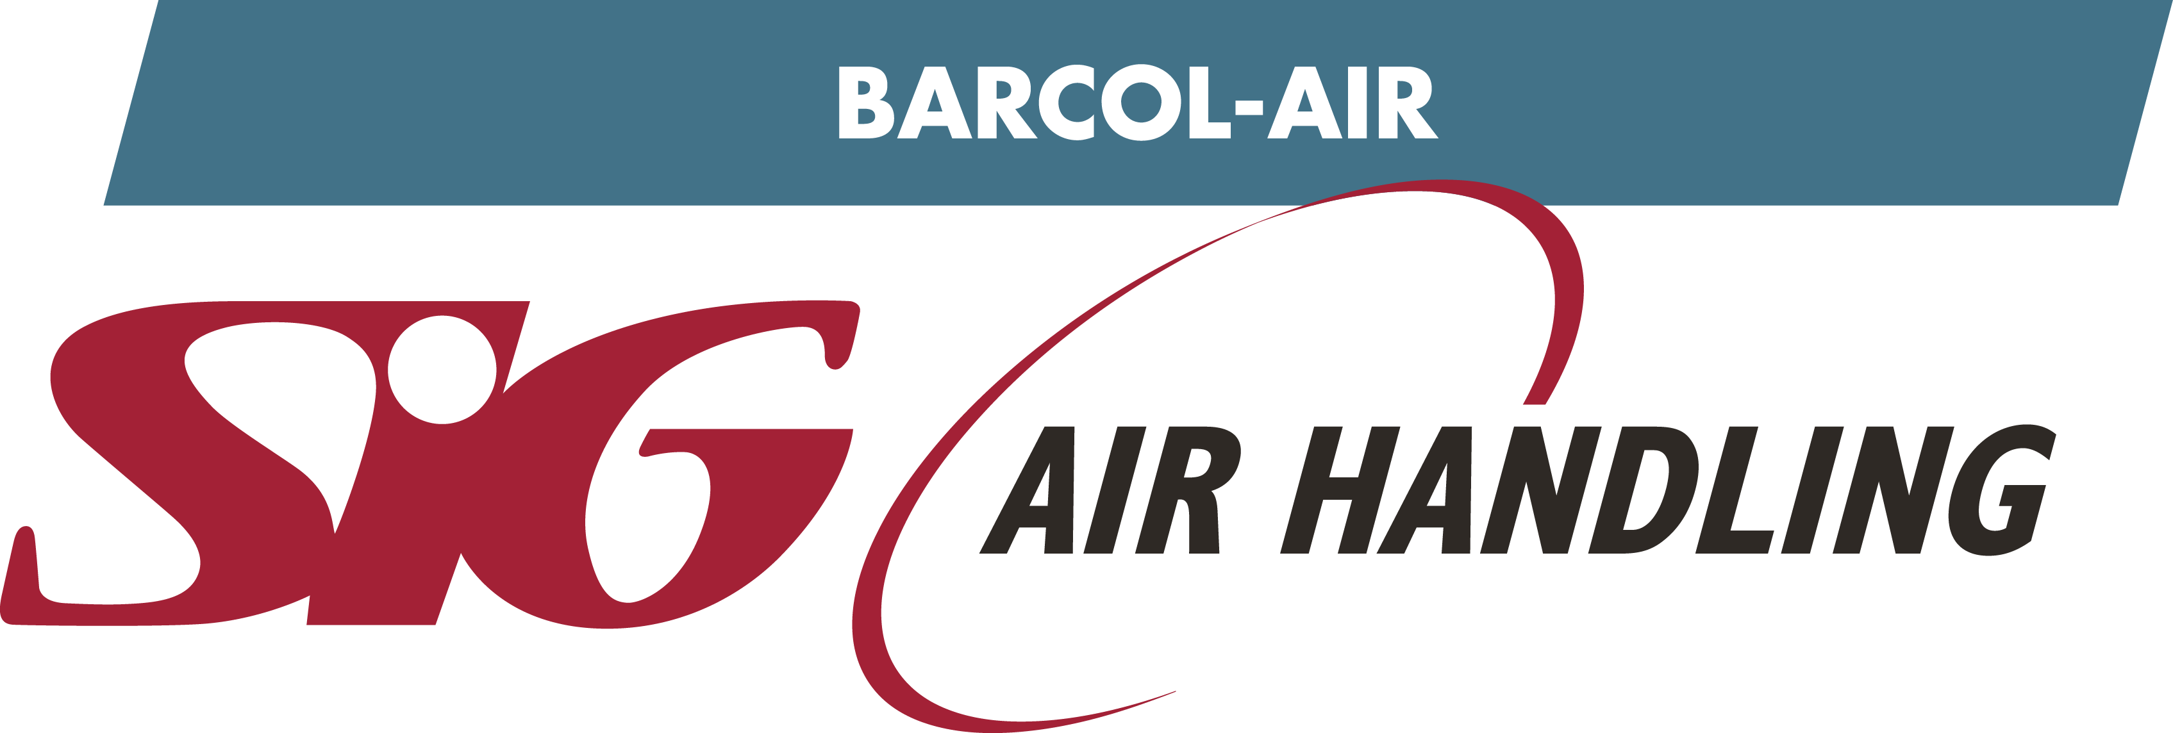
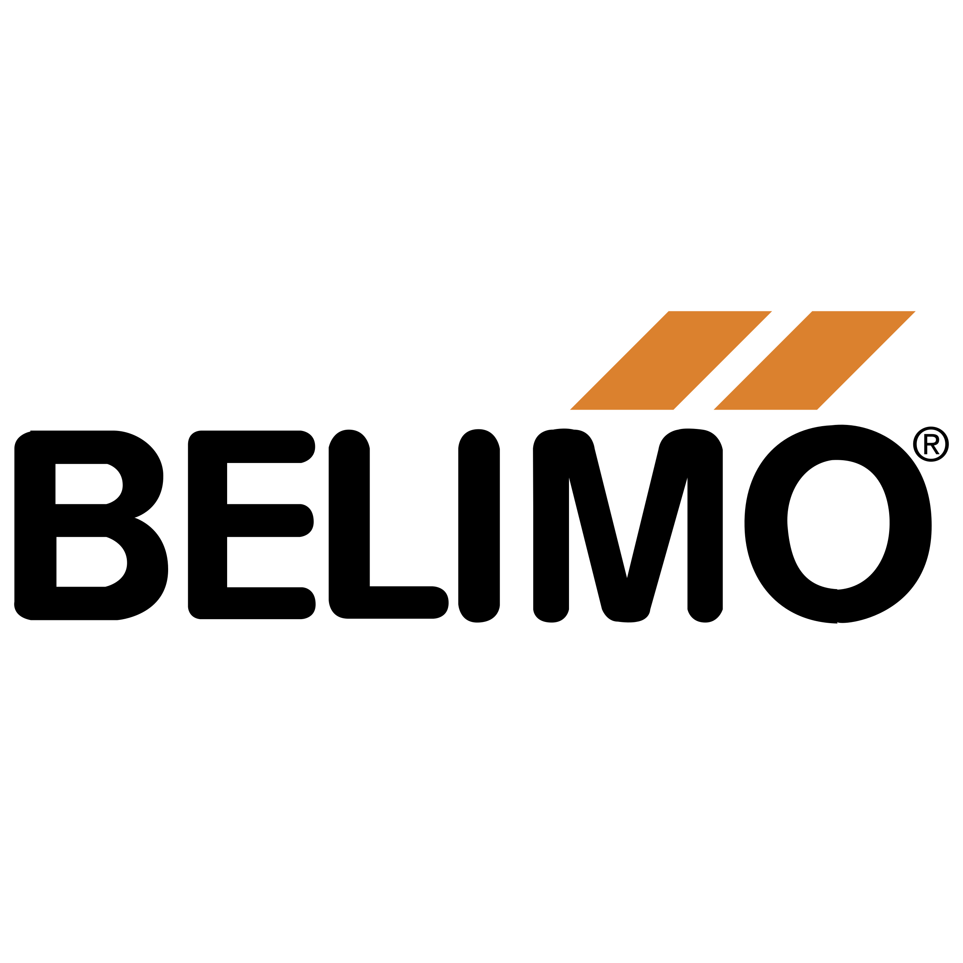
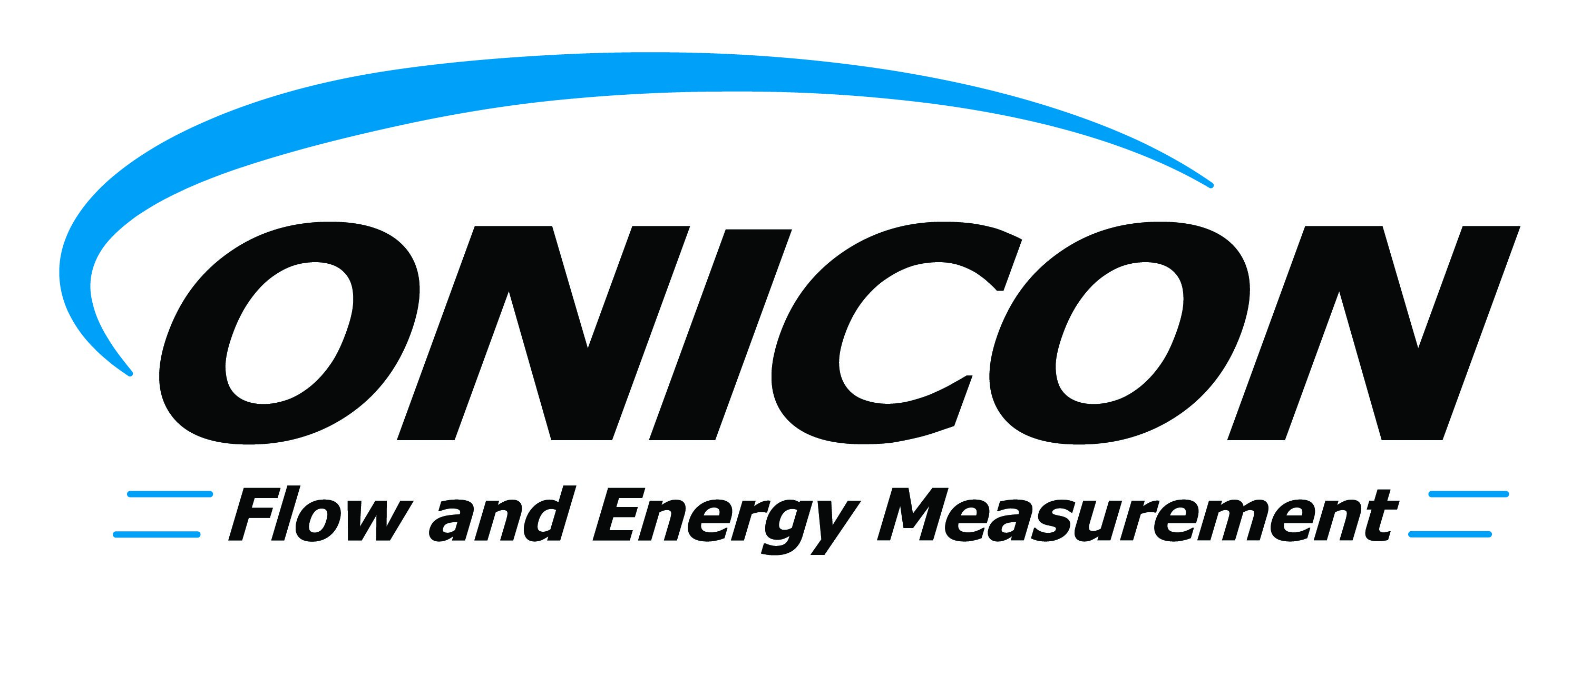
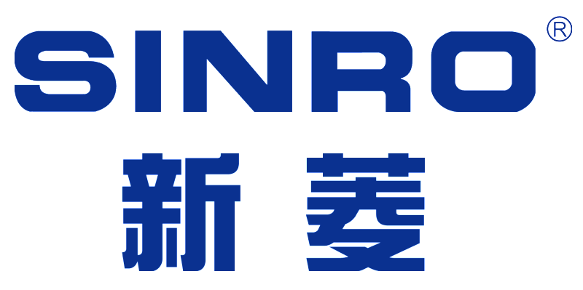
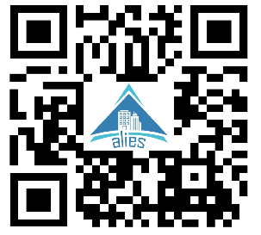
BRANDS WE ARE DEALING
POWER SOLUTIONS
Corporate Office
Office No. C 138, Retaj Buildings,
Mamoura, Salwa Road,
P.O.Box.200176, Doha, Qatar.
Phone : +974 40391379 Fax : +974 40390516
E-mail : info@aliesqatar.com
ISO CERTIFIED COMAPANY ISO 9001:2015 & ISO 45001:2018

